Slide 1





Building an ML-based Ensemble Model for Fraud Detection in Digital Banking Transactions
MSc Data Analytics with Banking and Finance Research Project Presentation
Student: LALI MANIKANTA GOWRISETTI (C5054253)
LaliManikanta.M.Gowrisetti@student.shu.ac.uk
Supervisor: Dr. JUMOKE POPOOLA
College of Business,Technology and Engineering (BTE)
Sheffield Hallam University

Slide 2

Acknowledgements
    I would like to thank my supervisor for the guidance, feedback and academic support provided throughout this project.
    I also acknowledge Sheffield Hallam University for providing the academic resources and learning environment required to complete the research.
Notes:
‹#›

Slide 3

Agenda
    Introduction
    Literature Review
    Methodology
    Ethics
    Implementation
    Results
    Evaluation
    Conclusion
    References
    AI Declaration
Notes:
‹#›

Slide 4
Research Aim and objectives
Introduction
Digital banking has been responsible for growing transaction volumes, but it's also made bank fraud more complex. Traditional rule-based and single model techniques can fall short when it comes to non-linear and evolving fraud patterns, and false positives can lead to customer friction (Manzoor & Aslam, 2025; Naeem, Butt & Javeid, 2026) .
Research Aim
    To develop a machine-learning-based ensemble model that enhances fraud detection precision and minimises false positives in high-velocity and diverse digital banking transactions.
    Research Objectives
To identify the recent trends and challenges in fraud detection for high-velocity digital banking transactions, with particular emphasis on class imbalance, missing data, and evolving fraud patterns.
To examine the effectiveness of machine learning-based ensemble techniques in improving fraud detection performance compared with individual machine learning algorithms.
To assess the impact of feature engineering, data pre-processing, and ensemble learning strategies on improving fraud detection precision while reducing false positives in digital banking transactions.
To determine the effectiveness of the proposed ensemble model by comparing its performance with baseline machine learning algorithms using evaluation metrics such as F1-score, AUC-ROC, precision, recall, and computational latency
Notes:
‹#›

Slide 5

Literature Review
The literature reveals that: As the literature indicates:
    Class imbalance, false positives, model selection and computational efficiency were identified as key issues in digital banking fraud detection, according to research.
    SMOTE and feature engineering have been extensively explored solutions for dealing with imbalanced data, with ensemble methods harnessing the strengths of multiple classifiers(George et al., 2025; Guterres et al., 2026; Rajasekar et al., 2026). Deep-learning methods can achieve good predictive performance; however, at significantly higher computational costs.
    Research Gap
    Some important balance between recalling fraud and reducing the false-positive rate, computational efficiency and robustness to changes in data conditions is still difficult to achieve in the existing research.
Notes:
‹#›

Slide 6


Methodology
The approach undertaken in the project was a quantitative and computational approach that was based on secondary data.
Dataset
The Bank Account Fraud Dataset for NeurIPS 2022.
    Nearly 1 million anonymised records
    30 features
    Severe class imbalance
    Process
    Data, pre-processing, 70/30 Stratified Split, SMOTE, Model Training, Ensemble, Evaluation
    To prevent data leakage, SMOTE was only used on the train set.
    Evaluation
    Precision, Recall, F1-score, AUC-ROC, False Positive Rate and computational latency were used to assess performance.
Notes:
‹#›

Slide 7
Ethics
    This project relied on a secondary dataset (pre-anonymised) that was made available to the public, and no primary data was collected or did human subjects participate.
    There was no personally identifiable information used, so there were no participant-related risks such as informed consent, privacy or participant identification. The information was kept in a secure way on storage that was password-protected.
    Ethics position: UREC2 Low Risk Human Participant Research Ethics documentation completed (no external or NHS approval required).
Notes:
‹#›

Slide 8
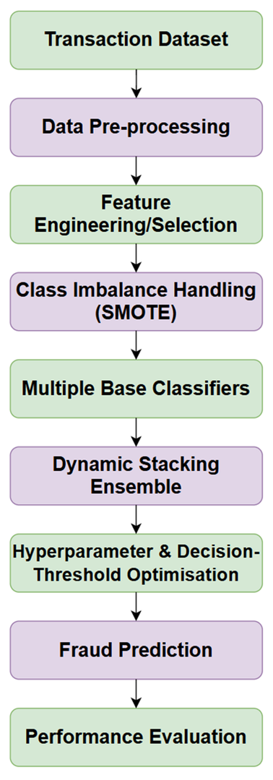

Project Design / Implementation
The design was developed to address class imbalance, fraud detection, false-positive control and computational latency.

Slide 9
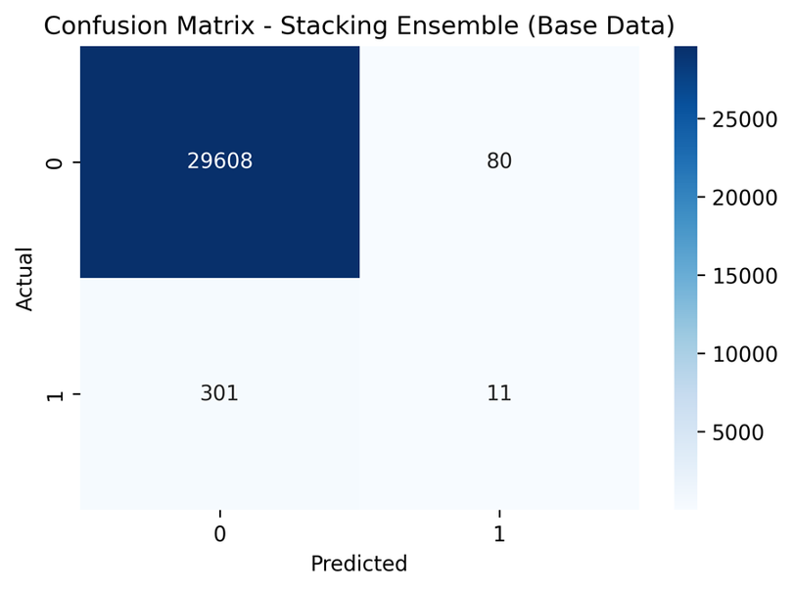
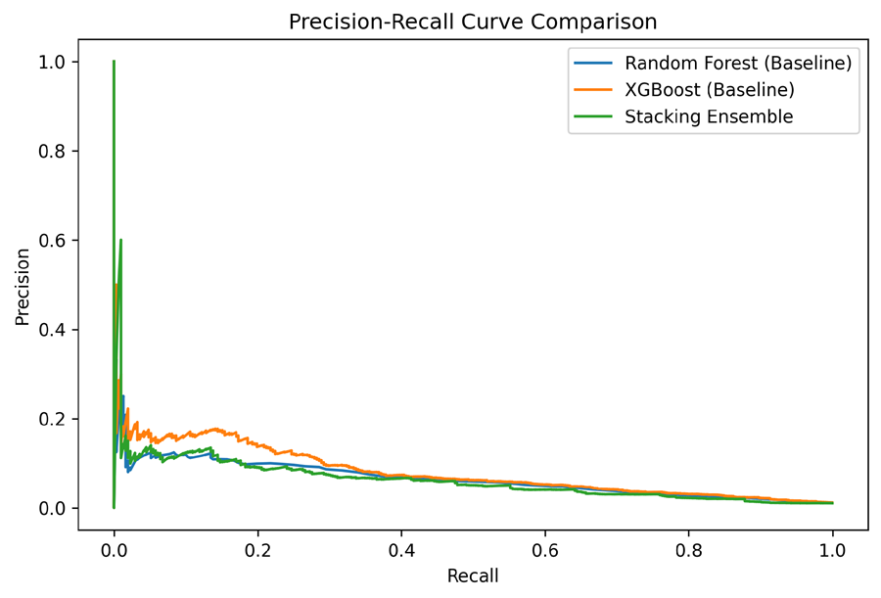
Prototype
As a result of this, the Fraud Detection Model was implemented.
    The prototype was written in Python with the help of pandas and scikit-learn.
    The model combines:
    Random Forest
    Baseline classifier
    XGBoost
    Baseline gradient-boosting classifier
    Stacking Ensemble
    The second model is a Random Forest + XGBoost meta-classifier with logistic regression.
    The entire process of preprocessing, SMOTE, model training, prediction and model performance evaluation were performed.
Stacking Ensemble Confusion Matrix.
Precision–Recall Trade-off for the Evaluated Models.
Notes:
‹#›

Slide 10
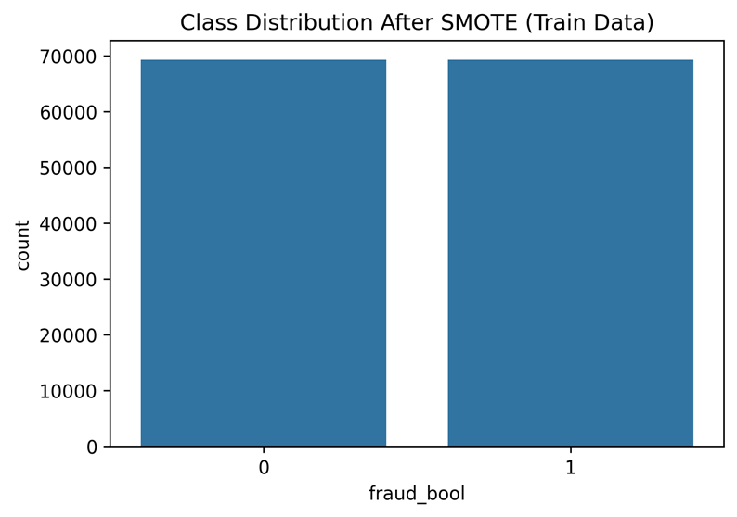
Results & Evaluation
Base Dataset
Key finding: XGBoost outperformed the Stacking Ensemble on the Base dataset, and trained significantly quicker.
Robustness
The Stacking Ensemble performed well on at least five variant datasets, achieving the best score of 0.1250 on Variant II.
Model | F1 | AUC-ROC | FPR | Training
Random Forest | 0.0451 | 0.8271 | 0.0026 | 39.94s
XGBoost | 0.0576 | 0.8441 | 0.0020 | 3.05s
Stacking | 0.0546 | 0.7838 | 0.0027 | 118.86s
Class Distribution After SMOTE.
Notes:
‹#›

Slide 11
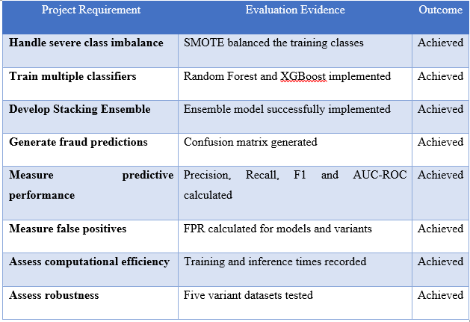
Evaluation
System Evaluation
    Eight system tests were performed; these included:
    Data loading, Pre-processing, SMOTE, Model Training, Ensemble Prediction, Performance Evaluation, False-Positive Testing, Computational Testing.
    There was a Passed grade for all 8 tests.
    Overall Evaluation
    The core technical requirements were met, such as class-imbalance treatment, model development, fraud prediction, model performance metrics, false-positive analysis, computational assessment and robustness testing.
    Limitations:
    The project was based on secondary, pre-anonymised data with no potential beneficiaries/human users participating. As such, evidence of user feedback and consent did not exist.
Evaluation against Project Requirements.
Notes:
‹#›

Slide 12

Conclusion
    The project was successful in building and testing a pipeline for fraud detection with machine learning techniques SMOTE, Random Forest, XGBoost and a Stacking Ensemble.
    The results indicated that the XGBoost had the greatest Base-dataset performance and the Stacking Ensemble had measurable robustness on the changing datasets. When it comes to stacking, however, it didn't improve upon XGBoost, and it took significantly longer to train.
    Final Finding
    The results of the research show that ensemble modelling can offer some good fraud-detection capability but it is not just a case of the bigger the ensemble, the better the performance.
    Further research can be done to enhance fraud recall, optimise the ensemble architecture, and minimise computational costs before going into actual banking applications.
Notes:
‹#›

Slide 13
References
    George, M. Z. H., Alam, M. K., & Hasan, M. T. (2025). Machine learning for fraud detection in digital banking: A systematic literature review. arXiv preprint arXiv:2510.05167. https://doi.org/10.63125/913ksy63
    Guterres, J. X., Widwaningtyas, T., & Zaeni, I. A. E. (2026). Fraud Identification in Online Financial Transactions Combining SMOTE and Ensemble Classifiers. Engineering, Technology & Applied Science Research, 16(2), 33323–33333. https://doi.org/10.48084/etasr.16615
    Manzoor, M. F., & Aslam, M. F. (2025). Enhancing banking fraud detection: Role of machine learning and deep learning methods. Premier Journal of Artificial Intelligence, 1(1). https://doi.org/10.70389/PJAI.100014
    Naeem, W., Butt, M. A., & Javeid, U. (2026). Machine Learning-Based Fraud Detection Systems and Their Effectiveness in Reducing Cybersecurity Risks in Digital Banking. Social Science Review Archives, 4(2), 2553–2573. https://doi.org/10.70670/sra.v4i2.2344
    Rajasekar, A., Patra, S., Dua, R., Rajmane, A., & Atulker, P. K. (2026). Machine Learning Applications in Fraud Detection for Digital Banking. International Journal of Advances in Signal and Image Sciences, 1880–1895.
Notes:
‹#›

Slide 14
AI Transparency Scale (AITS) Declaration
    This assessment aligns with **AITS Level 2 (AI for shaping)** configurations permitted under university academic conduct policies.
    AI tools were used to support the preparation of this presentation, including language refinement and proofreading, while the research, analysis, implementation, results, and conclusions were independently human-generated.
Notes:
‹#›

Slide 15
Thank You

